Slide 1
EfficientNet with RandAugment for Diabetic Retinopathy Detection
Yurun SONG
MSc Advanced Computing

Slide 2
Outlines
Introduction
Objectives and challenges
Classification models
Image Augment
Implementation
Results
Q&A

Slide 3
Introduction
EfficientNets
A series of models from B0 to B7 with different model sizes
Systematical scaling method for depth, width and resolution
Diabetic Retinopathy (DR)
Common diabetic eye diseases.
High blood sugar level leads to damage of the small vessels in the retina.
According to NHS 2019, 1280 new cases of blindness caused by DR are reported each year in England alone, while a further 4 200 people are in the risk.
Image Augment
Artificially expand the size of dataset by creating variation of images
Potentially enhance the robustness of the model
Performs as a regularization for complex models

Slide 4
Objectives & challenges
Objectives
Constructing an EfficientNet baseline model and restore the experiment in the original paper [7] about Cifar datasets .
Achieving the high performance on the Diabetic Retinopathy (DR) dataset using pretrained EfficientNet model.
Challenges
Some common training techniques are not suitable for the EfficientNet.
Like optimizer RMSProp is best and batch size for training ImageNet is extreme large.
Imbalance classes and noises in the DR dataset are the challenges for the training.

Slide 5
Background
Classification models
Image Augment

Slide 6
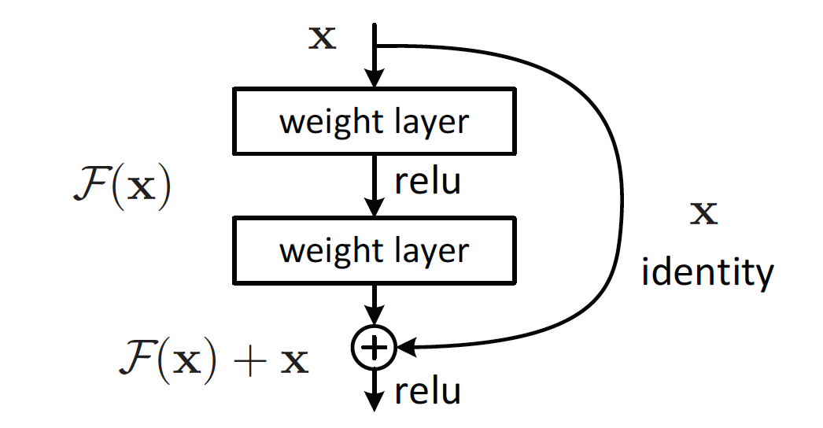
ResNet & ResNeXt
Problems:
Gradient vanishing/exploration
Increasing layers could decrease the accuracy.
Skip connection
Simply provides the option for Neural Network to backpropagation or skip the layer.
More flexible paths are added.
EfficientNet
Skip connection is used in the EfficientNet blocks
When performing backPropagation, the loss are kept through the shortcut.[1]

Slide 7
ResNet & ResNeXt
ResNet
Residual block (Left)
Motivation
Each channel shares the same weights
Traditional transformation for the residual block is too simple
ResNeXt
Improvement for Residual block (Right)
New dimension: cardinality
Controls the detail of channel weights
ResNeXt-50 32x4d and ResNeXt-101 32x8d are the previous best model for DR dataset
ResNeXt [2]
Input dimension 256, output dimension 256
Internal layer split into 32 paths (groups)
Each path performs a non-linear transformation and aggregated to a complex transformation.
Cardinality is divisible by input and output channels

Slide 8
MobileNet V1 & V2
MobileNets are the architectures designed for mobile and embedded devices.
MobileNet V1
Motivation:
Traditional convolution is too expensive.
Depthwise Separable Convolution
Depthwise Convolution
Kernel dimension =1
Pointwise Convolution
Kernel height and width = 1
Benefits
Sacrifice a small amount of accuracy but significantly reduce the computational time.

Slide 9
MobileNet V1 & V2
MobileNet V2
Applies depthwise separable convolution to N-N block structure
Inverted residual bottleneck
It combines a residual block architecture and depthwise separable convolution.
ReLU
ReLU is not good at preserve information in the high dimension.
EfficientNets
Inverted residual block is the prototype of the blocks in EfficientNets

Slide 10
ResNet & MobileNet V1& V2

Slide 11
Squeeze and Excitation (SE) layer
Motivation
Each output feature map shares the same weight
SE layer finds an adaptive and optimal way to adjust the weight of each feature map
Stages
Squeeze
global average pooling to channel wise features
Excitation
Full connected layer with ReLU (No linear)
Full connected layer with sigmoid
Scale
Multiple with input X
EfficientNets
Directly add SE layer into each block
SE Layer [3]

Slide 12
NasNet & MNasNet
Neural Architecture Search Network (NasNet)
Neural Architecture Search for Mobile (MNasNet)
Motivation
Automatically searching the best model for a dataset
Components for NasNet
RNN controller
Architectures (pre-defined)
Convolutional Cells
Blocks

Slide 13
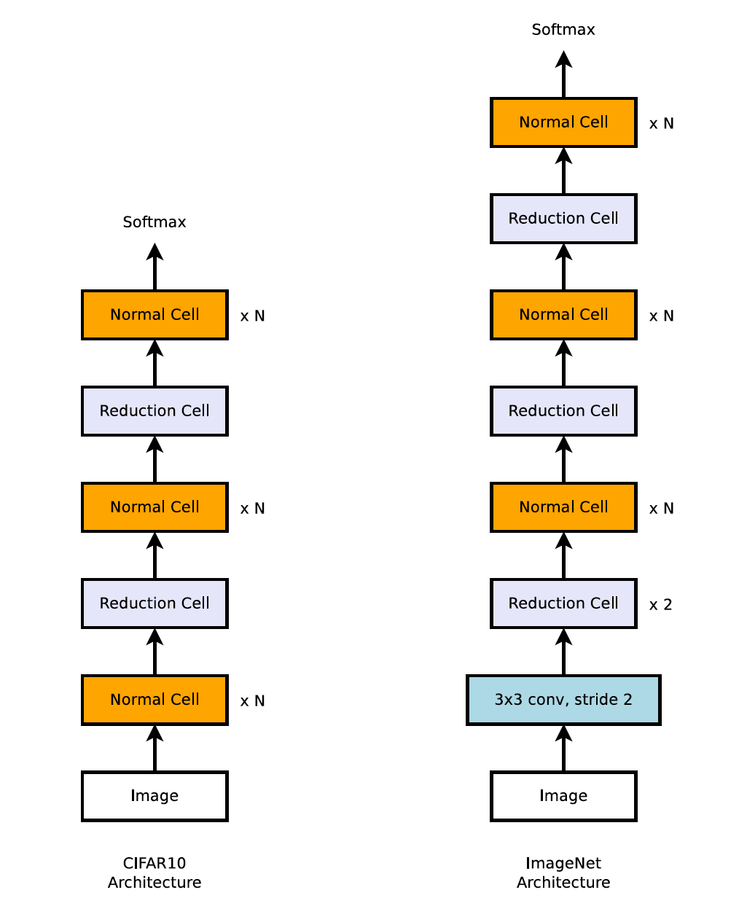
RNN controller [4]
Block [4]
Normal & reduce cells [4]
Architectures [4]

Slide 14
NasNet & MNasNet
Motivation for MNasNet
Find best model with the highest accuracy and the lowest Latency (Efficiency)
Only two kinds of cells are searched for NasNet
Components for MNasNet
RNN controller
Architecture (pre-defined)
Blocks
Layers
MBConv (Mobile inverted Bottleneck Block)
An evolution from inverted residual bottleneck (MobileV2)
Add expand_ratio

Slide 15
RNN controller [5]
MB Conv [5]
Blocks and layers [5]

Slide 16
Swish
Motivation
ReLU doesn’t show a consistent gain with the increasing dimension
if 𝛽 = 1, swish is equivalent to the Sigmoid-weighted Linear Unit (SiL).
If 𝛽 = 0, it becomes the scaled linear function f(x) = x/2 .
If 𝛽 close to infinity, the sigmoid component approaches a 0-1 function and swish turns to the ReLU function.
A smooth function that non-linearly interpolates between the linear function and the ReLU function

Slide 17
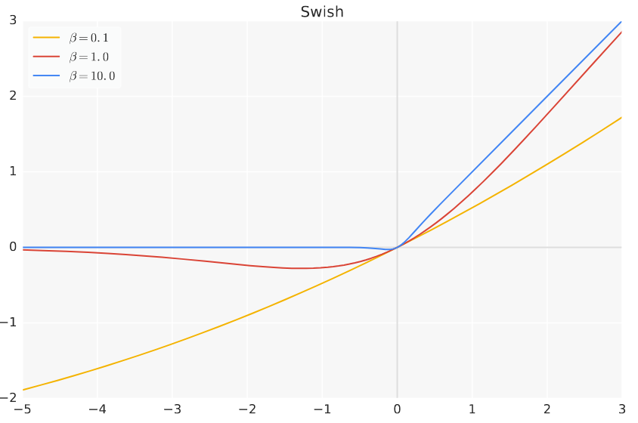
Swish
f(x) = x * 𝜎 (𝛽x)
where 𝜎 is the sigmoid function and 𝛽 is a parameter
Replace ReLU6 in the EfficientNet models
Swish [6]

Slide 18
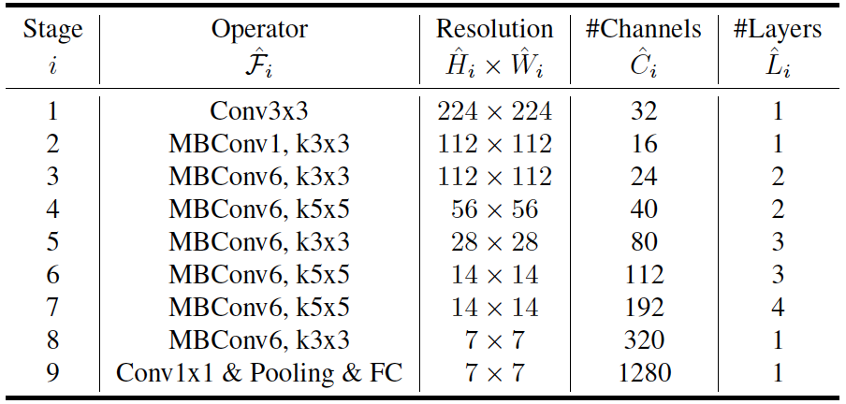
EfficientNet
EfficientNet-B0 Baseline
Searched by MNaset with larger FLOPS allowance
Compound Scaling method
Scales another 7 models from B0
Transfer Learning performace
State of art in 5 out of 8 datasets
EfficientNet-B0 Baseline [7]

Slide 19
EfficientNet
Channel
n
6n
6n
n
PW 1x1
EfficientNet-B0
MBConv with SE layer is the foundation
MB Conv with SE layer
Replace ReLU6 with Swish
Add BN after each Conv layer
Multipliers
Width Multiplier
Depth Multiplier
Resolution Multiplier
DW 3x3
SE Layer
PW 1x1
MBConv6 (3x3)

Slide 20
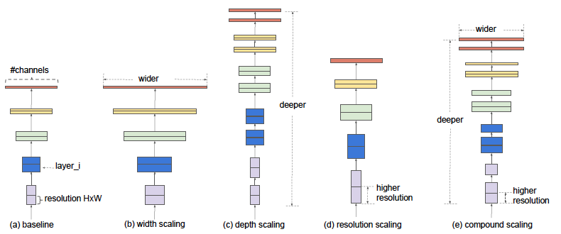
EfficientNet
Scaling
Width
Easier to train
But much faster to reach saturation
Depth
Difficult to train due to the vanishing gradient
Diminishing accuracy for a very deep neural network.
Resolution
High resolution capture more fined-grained features
The accuracy gain diminishes for very high resolutions
Scaling method [7]

Slide 21
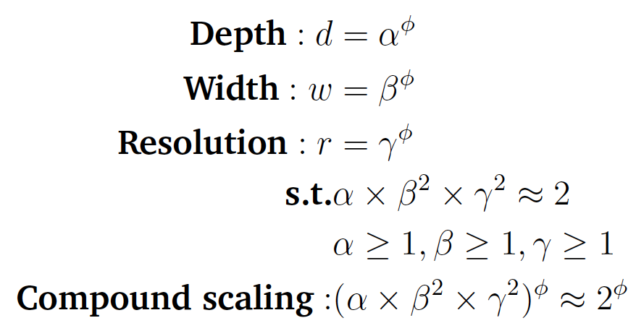
EfficientNet
Compound Scaling methods
Depth (d)
With coefficient 𝛼
Width (w)
With coefficient 𝛽
Resolution (r)
With coefficient 𝛾
Compound scaling coefficient 𝜙
Control the allowance of FLOPS
Constrained by Efficiency (FLOPS)
The coefficients are corresponding to each multiplier.
Double depth, double FLOPS
Double Width, quadruple FLOPS
Double Resolution, quadruple FLOPS
With exponential growth of FLOPS, the allowance of Depth, width and resolution increases.

Slide 22
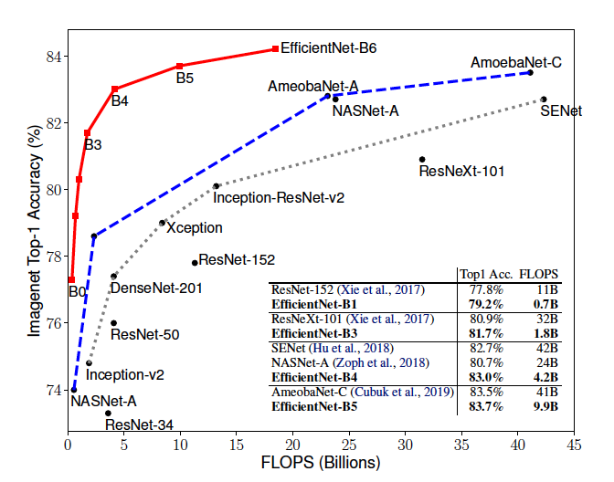
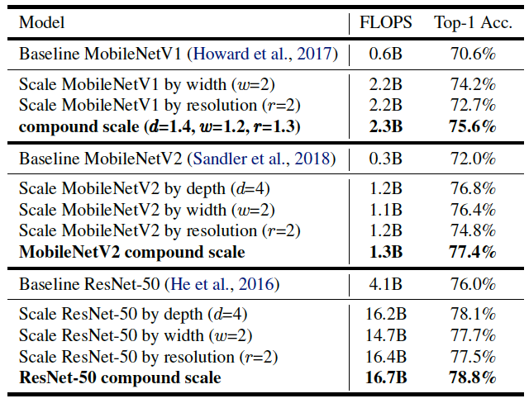
EfficientNet
ImageNet performance
Scaling Up MobileNets and ResNet
Transfer Learning performance
Scaled EfficientNet models achieve new state-of-the art accuracy for 5 out of 8 datasets, with 9.6x fewer parameters on average.
Like Cifar-100
Performance [7]

Slide 23
AutoAugment
Motivation
An automatic way to get the optimal augmentation policy
Generates transformation operations
Components
RNN controller
5 sub policys are ready for a mini-batch,
Each sub policy contains 2 operations,
Each operation has a probability and magnitude.
Search space
16 operations, 10 magnitudes, 11 probabilities
(16*10*11)^2 for a sub policy
(16*10*11)^10 = 2.9*10^32 for a policy

Slide 24
AutoAugment
Exhaustive search for all possibilities is expensive.
Applies fixed AutoAugment policy to training EfficientNets on ImageNet.
RNN controller [8]
Examples for AutoAugment [8]

Slide 25
RandAugment
Motivation
AutoAugment is too costly (extreme large search space)
Training small models on small datasets and subsequently applied to a larger models.
proxy task could achieve sub-optimal results.
Unable to adjust the regularization strength based on the model and data size
RandAugment
Dramatically reduces the search space without the need for a separate proxy task.
Two hyperparameters
Number of operations (K) and magnitude of operations (M)
14 operations

Slide 26
RandAugment
Findings
Each operation is selected with unformal probability 1/K
Average performance increases with the number of operations increases
Some operations will contribute while others not, depends on the dataset
Optimal magnitude value depends on the size of both network and training datasets
Magnitude value for different operations is not essential.
One magnitude for all operations
Search space
10^2

Slide 27
Adversarial Propagation
Motivations
Training noise images to increase the robustness of a model,
Force the model less sensitive to texture distortions and focus more on shape information.
Too many noises lead to a decline in the accuracy.
Adversarial Propagation
An enhanced adversarial training scheme which treats adversarial examples as additional examples, to prevent overfitting
Auxiliary batch normalization
Disentangle the mixed distributions between clean and adversarial image
Keep the detachable feature maps into separate domains so that the features are still distinctive in the next layer.

Slide 28
Adversarial Propagation
These two separate BNs solves the distribution mismatch of two datasets and guarantee the network extracts valuable features from both domains accurately and effectively.
Auxiliary Batch normalization [9]

Slide 29
Self training with noise student
A kind of training technique
Steps
Train a teacher model on labeled images
Use the teacher model to generate pseudo labels on unlabeled images
Train an equal or larger student model on the combination of labeled images and pseudo labeled images with noises
Student model converts to a teacher model and produce new pseudo labels again.
Self training with noise student [10]

Slide 30
Self training with noise student
Example
EfficientNet B7 as teacher model
training a scaled and much larger model EfficientNet L2 as student model
EfficientNet L2 as teacher and iterative training a new L2 model
EfficientNet-B5-ns
Use EfficientNet-B5 as both teacher and student
Apply randAugment to all EfficientNet-B5
Noisy Student leads to a consistent improvement of around 0.8% for all model sizes
Noise student provides a much better trade-off between model size and accuracy than prior works.

Slide 31
Implementation
Cifar
DR dataset

Slide 32
Cifar
Learning from scratch on Cifar10/100
Create an EfficientNet-B0 Baseline
Use predefined scaling coefficients to scale B0 to B5
Training on the Cifar datasets
Pretrained EfficientNet on Cifar10/100
Pretrained EfficientNet models
Fine tunning on the Cifar datasets

Slide 33
DR dataset
DR dataset
5 classes (No DR, Mild DR, Moderate DR, Severe DR, Proliferative DR)
88K images, where 35K for training, 11K for public test and 42K for private test
Imbalance
Majority samples are No DR (74%) and other four categories account for 14%, 7%, 2% and 2% respectively
Noises
retina images come from the different models and types of cameras
According to descriptions of data, images may contain artifacts, be out of focus, underexposed or overexposed. Like any real-world data set, noise in both the images and labels are exists.

Slide 34
DR dataset
RandAugment
More weights to shape transformation
Magnitude 3 and operations 2
Balanced Sampler
Class weight (0.272, 2.875, 1.327, 8.047, 9.922)
Directly copying the entire class images N times where N is integer multiples
For the decimal part, samples the class images without replacement.
Original
RandAugment

Slide 35
Experiment Result
Cifar 10
Cifar 100
EfficientNets without BalancedSampler
EfficientNets with BalancedSampler and RandAugment
EfficientNets with other DR dataset

Slide 36
Cifar10
Model | Batch size | Learning from scratch | Transfer Learning | Best Result
EfficientNet B0 | 32 | 0.8593 | 0.9673 | 0.981
EfficientNet B3 | 32 | 0.8863 | 0.9769 | ---
EfficientNet B5 | 8 | 0.8662 | 0.9754 | ---
Best Result comes from the Paper, with 1.37% error between my results
Batch size for B5 is smaller due to the limitation of memory.
Learning from scratch on ImageNet with batch size 4096

Slide 37
Cifar100
Model | Batch size | Learning from scratch | Transfer Learning | Best Result
EfficientNet B0 | 32 | 0.5704 | 0.8446 | 0.8810
EfficientNet B3 | 32 | 0.6146 | 0.8651 | ---
EfficientNet B5 | 8 | 0.5294 | 0.8595 | ---
Cifar100 has about 3.64% test error between the best performance on paper [7]
Efficientnet B5 doesn’t reach an ideal performance. This is mainly because the batch size. Large batch size is necessary for EfficientNet. The batch size heavily impacts the accuracy of learning from the scratch than transfer learning.
Therefore, the batch size significantly affects the accuracy for DR dataset

Slide 38
EfficientNets without BalancedSampler
Model | parameters | Public test | Private test
Kaggle | --- | 0.8603 | 0.8496
ResNeXt-50 | 25M | 0.8498 | 0.8404
ResNeXt-101 | 88M | 0.8609 | 0.8519
EfficientNet-B5 | 30M | 0.8562 | 0.8452
EfficientNet-B5-ap | 30M | 0.8538 | 0.8455
EfficientNet-B5-ns | 30M | 0.8708 | 0.8581
EfficientNet-B5 with noise student has the best performance on the private test.
EfficientNet-B5-ns is less than a half of size ResNeXt-101but 0.62% improvement on overall accuracy.
EfficientNet-B5 has better performance than the similar size model ResNet-50 as well.

Slide 39
EfficientNets without BalancedSampler
EfficientNet-B5-ns
ResNeXt-101

Slide 40
EfficientNets without BalancedSampler
EfficientNet-B5-ns has better performance in Moderate, Severe and Proliferative DR three categories(With 3.68%, 5.83%,10.97% improvement) in sensitivity.
Similar accuracy in No DR class and worse result in Mild DR(Drop 3.91%) section.
ROC curve illustrates that Mild DR is the class that the most difficult to distinguish with other classes

Slide 41
Precision & recall curve
ResNet-101
EfficientNet-B5-ns

Slide 42
EfficientNets with BalancedSampler and RA
With BalancedSampler and RandAugment
In term of results, the performance is not as good as without BalancedSampler.
Model | Public test | Private test
EfficientNet-B5 | 0.7949 | 0.7847
EfficientNet-B5-ap | 0.8174 | 0.8057
EfficientNet-B5-ns* | 0.8284 | 0.8160
* Latest Results not in the report

Slide 43
EfficientNets with other DR dataset
Aptos [11]
A new dataset on Kaggle for detecting diabetic retinopathy with the same five labels.
3662 Images, imbalanced, which has No DR (49.29%), Mild DR (10.10%), Moderate DR (27.28%) Severe DR (5.27%) and Poliferative DR (8.06%).
Mild DR has only 0.01% while other four classes performs pretty well in sensitivity.
Model | Performance
EfficientNet-B5 | 0.7073
EfficientNet-B5-ap | 0.7261
EfficientNet-B5-ns | 0.7425

Slide 44
Conclusions & Future work
EfficientNets are widely used for satisfying various kinds of datasets.
Compound scaling method can be applied to other specific models.
EfficientNet-B5-ns achieves the best overall accuracy.
Future work
Compound scaling method for ResNeXt and other models
Increase batch size can get better performance
Considering about the noises in Mild DR class and attempt using Semi-supervised learning like training with noise student

Slide 45
References
[1] He, K., Zhang, X., Ren, S. and Sun, J. (2016), Deep residual learning for image recognition
[2] Xie, S., Girshick, R., Doll´ar, P., Tu, Z. and He, K. (2017), Aggregated residual transformations for deep neural networks,
[3] Hu, J., Shen, L. and Sun, G. (2018), Squeeze-and-excitation networks, in ‘Proceedings of the IEEE conference on computer vision and pattern recognition’,
[4] Zoph, B., Vasudevan, V., Shlens, J. and Le, Q. V. (2018), Learning transferable architectures for scalable image recognition,
[5] Tan, M., Chen, B., Pang, R., Vasudevan, V., Sandler, M., Howard, A. and Le, Q. V. (2019), Mnasnet: Platform-aware neural architecture search for mobile,
[6] Ramachandran, P., Zoph, B. and Le, Q. V. (2017), ‘Searching for activation functions’, arXiv preprint arXiv:1710.05941 .
[7] Tan, M. and Le, Q. V. (2019), ‘Efficientnet: Rethinking model scaling for convolutional neural networks’, arXiv preprint arXiv:1905.11946 .
[8] Cubuk, E. D., Zoph, B., Mane, D., Vasudevan, V. and Le, Q. V. (2019), Autoaugment: Learning augmentation strategies from data
[9] Xie, C., Tan, M., Gong, B., Wang, J., Yuille, A. and Le, Q. V. (2019), ‘Adversarial examples improve image recognition’, arXiv preprint arXiv:1911.09665 .
[10] Xie, Q., Hovy, E., Luong, M.-T. and Le, Q. V. (2019), ‘Self-training with noisy student improves imagenet classification’, arXiv preprint arXiv:1911.04252 .
[11] APTOS 2019 Blindness Detection (2019). URL: https://www.kaggle.com/c/aptos2019-blindness-detection/overview

